Slide 1
CS 2200 Systems and Networks

Slide 2
Administrative Information
Instructor: Bob Waters
Room 138, CCB
Email : watersr@cc.gatech.edu
Office hours: Tuesdays 0800 – 1100 and by appointment
Canvas for assignments, syllabus, etc

Slide 3
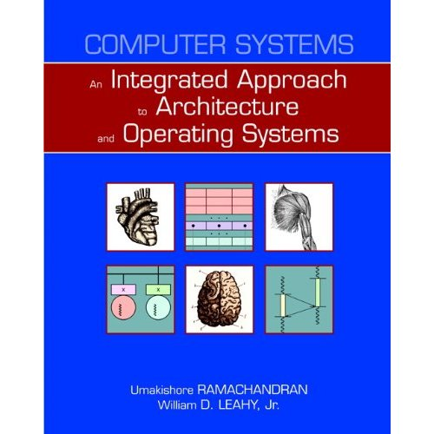
Textbooks
Paperback: 784 pages
Publisher: Addison Wesley; 1 edition (August 9, 2010)
Language: English
ISBN-10: 0321486137
ISBN-13: 978-0321486134
Average Customer Review: 5.0 out of 5 stars

Slide 4
Point of Continuity (Course Owner)
Kishore Ramachandran
Office: KACB 2338
Office Hours
TBA
and by appointment
Email: rama@cc.gatech.edu

Slide 5
Motivation
How many of you are taking this because you’re interested in the subject matter?
How many of you are taking this because it's required?
Systems Thread??
Internetworking Thread??

Slide 6
This Stuff is Actually Important
Understanding the compiler target
Understanding what is going on under the hood
Being able to understand and explain what all those computer terms mean in a PC advertisement. (2MB L1 4 way associative cache)
Understanding threading and the evils of “busy waiting”
Setting data structures to take advantage of memory structure
About 40% of the GRE questions!

Slide 7
Prerequisites
CS2110
Sequential and combination logic
Memory
CPU/Datapath
Instruction-set
C programming
Translation Process
Preprocessing, Compilation, Linking, Loading
Unix
etc.

Slide 8
Course Outline
Broad exposure to computer systems
Organization of the processor
Memory hierarchy
Storage devices
Parallel processors
Networking hardware
Software abstractions in the operating systems for orchestrating their usage
Networking protocols to connect the computer system to its environment.

Slide 9
Major Topics
Processor
Memory hierarchy
I/O subsystem
Parallel systems (Threading and Thread Safety)
Networking.

Slide 10
Homework/Projects
Significant homework and project component to go with each topic.
3 lab hours in the course credit.
An excellent knowledge of C programming is essential for completing the projects

Slide 11
Homework: Subject to Change
Projects
1 LC2200 Datapath/Control
2 I/O Interrupt handler
3 Pipelining
4 Virtual memory
5 Multi-Threaded Operating System
6 Networking

Slide 12
Grading Scale
5% - Participation (Turning Tech Response)
30% - Projects (weighted equally)
10% - Homeworks
40% - Tests
15% - Final Exam
100% Total

Slide 13
Collaboration
Collaboration is allowed and encouraged in this class
Collaboration means that you can discuss assignments, look at another student’s code and help one another out.
This is not a group project class unless an assignment is specifically designated as such.
Each student is required to turn in their own homework or project.
Each student will be required to demo selected assignments and will be expected to be able to understand and explain every part of their submissions
Help each other, but do the actual work yourself. Identical code submissions or identical processor layouts will be flagged as suspect!!!

Slide 14
Collaboration
You are expressly forbidden to supply a copy of your homework to another student via electronic means. If you supply an electronic copy of your homework to another student and they are charged with copying you will also be charged. This includes public repositories. That is you must not store your code in a location where others may access it.
Homework and projects that are obviously nearly identical will receive a zero and will be sent to the Dean of Students Office of Student Integrity for investigation and possible prosecution. This includes assignments where nearly identical assignments are altered to make them appear different.

Slide 15
CS 2200 Rules and Regulations
On all emails to the instructor and TA's please make sure to include the course in the subject. Also, please sign with your real name.
Late penalties are severe and enforced.

Slide 16
CS 2200 Rules and Regulations
2. You are responsible for turning in assignments on time. This includes allowing for unforeseen circumstances. In other words, plan ahead, start early, finish early.
3. In general, programming assignments should be turned in with a Makefile and all files needed to compile and run the program. The TA grading your submission should be able to make and run your program without adding files, repairing things etc.
4. Tests, quizzes and examinations must be taken at the scheduled date and time.

Slide 17
CS 2200 Rules and Regulations
5. If you need a certain grade in order to stay in school, maintain a scholarship, etc. the time to worry about this is right from the beginning of the course not during the week before finals. Grades are based on demonstrated performance not individual need based on factors external to the course. Please do not request special consideration based on this type of situation.
6. Final grades will be available from OSCAR normally sometime the week after finals. You may review your final and discuss your grades during the following semester in which you are attending Ga Tech. Grades will not be discussed over break.

Slide 18
CS 2200 Rules and Regulations
7. If you have any personal problems (family/illness/etc.) please go to the Dean of Student's office located in the Student Services Building (Flag Building) next to the Student Center. She is equipped and authorized to verify the problems and she will issue a note to all your instructors making them aware of the problem and requesting whatever extension, etc. is necessary.
8. Canvas announcements should be checked every day. Official announcements about course matters will be posted there. Complaints, questions about your personal problems, etc. should be discussed with your instructor in person or via email.

Slide 19
CS 2200 Rules and Regulations
9. Out of consideration to your fellow students please turn off cell phones, beepers, wristwatch alarms, etc. Also, make every effort to be on time for class. If you unavoidably late, please sit near the back and try to avoid as much disruption to the class as possible.
10. If you are graduating and need this course to do so please inform your instructor as soon as possible.
11. Complaints about any aspect of the course should be directed to the course instructor during office hours or via email.

Slide 20
CS 2200 Rules and Regulations
12. The deadline for regrades is 2 weeks after an assignment grade is posted or returned to you. This deadline also applies to picking up items which are returned in class. After this deadline no grade changes will be made and tests not picked up will be destroyed.

Slide 21
LogiSim
We will be using LogiSim this semester for the circuit projects 1, 2, 3
Google: LogiSim

Slide 22
Bob’s Advice
Visit TA’s early and often
Read the book!!!!

Slide 23
Questions?

Slide 24
Levels of Abstraction in a Computer System
Application (Algorithms expressed in High Level Language)
System software (Compiler, OS, etc.)
Computer Architecture
Machine Organization (Datapath and Control)
Sequential and Combinational Logic Elements
Logic Gates
Transistors
Solid-State Physics (Electrons and Holes)

Slide 25


Networked
Video Game
Compiler
compiler
analysis
synthesis
Instruction
Set
swap ld r1 r2
add r3 r6 r7
sub r5 r4 r3
jsr mult
Datapath &
Control
Control
Datapath
Logic
Elements
Decoder
Mux
Gates
Transistors
Electrons &
Holes
+
+
+
+
+
+
+
-
-
-
-
-
-

Slide 26
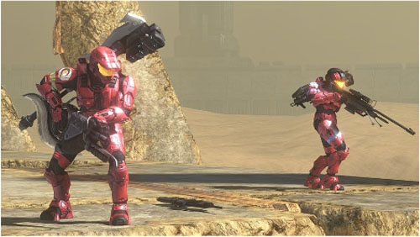
Levels of Abstraction

Slide 27
Video Game
Compiler
Instruction-Set
Datapath and Control
Video and Audio
Content
HLL Source
Program
Logic Elements
Gates
Transistors
Electrons and Holes
Hardware
Software

Slide 28
The Role of the Operating System?
Resource manager
Provide consistent interface to resources
Job scheduler

Slide 29
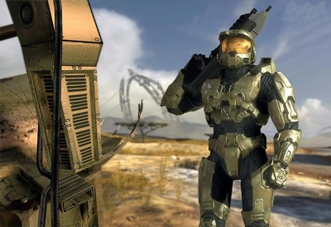

Client Application
(Halo 3)
Player clicks mouse
cursor on target

Slide 30
Client Application
(Halo 3)
Player clicks mouse
cursor on target
OS: Recognizes interrupt
Sends it to client application
It's a mouse interrupt!

Slide 31
Client Application
(Halo 3)
Player clicks mouse
cursor on target
OS: Recognizes interrupt
Sends it to client application
It's a mouse interrupt!
CLIENT

Slide 32

Client Application
(Halo 3)
Player clicks mouse
cursor on target
OS: Recognizes interrupt
Sends it to client application
It's a mouse interrupt!
CLIENT
Client Application creates
message to send to server
application

Slide 33

Client Application
(Halo 3)
Player clicks mouse
cursor on target
OS: Recognizes interrupt
Sends it to client application
It's a mouse interrupt!
CLIENT
Client Application creates
message to send to server
application
OS: Sends
Message to
server

Slide 34
Client Application
(Halo 3)
Player clicks mouse
cursor on target
OS: Recognizes interrupt
Sends it to client application
It's a mouse interrupt!
CLIENT
Client Application creates
message to send to server
application
OS: Sends
Message to
server
OS: Receives
Message sends
to server application
Got a message!
SERVER

Slide 35
Client Application
(Halo 3)
Player clicks mouse
cursor on target
OS: Recognizes interrupt
Sends it to client application
It's a mouse interrupt!
CLIENT
Client Application creates
message to send to server
application
SERVER
OS: Sends
Message to
server
Application examines
message and state of
game and determines
Master Chief dies! Sends
message back to client.
OS: Receives
Message sends
to server application
Got a message!

Slide 36
Client Application
(Halo 3)
Player clicks mouse
cursor on target
OS: Recognizes interrupt
Sends it to client application
It's a mouse interrupt!
CLIENT
Client Application creates
message to send to server
application
SERVER
OS: Sends
Message to
server
Application examines
message and state of
game and determines
Master Chief dies! Sends
message back to client.
OS: Receives
Message sends
to server application
Got a message!
OS: Sends
Message to client

Slide 37
Client Application
(Halo 3)
Player clicks mouse
cursor on target
OS: Recognizes interrupt
Sends it to client application
It's a mouse interrupt!
CLIENT
Client Application creates
message to send to server
application
SERVER
OS: Sends
Message to
server
OS: Receives
message and
sends it to
application
Application examines
message and state of
game and determines
Master Chief dies! Sends
message back to client.
Got a message!
OS: Receives
Message sends
to server application
OS: Sends
Message to client

Slide 38
Client Application
(Halo 3)
Player clicks mouse
cursor on target
OS: Recognizes interrupt
Sends it to client application
It's a mouse interrupt!
CLIENT
Client Application creates
message to send to server
application
ClientApplication generates
required images, etc.
Sends I/O requests to OS
SERVER
OS: Sends
Message to
server
OS: Receives
message and
sends it to
application
Application examines
message and state of
game and determines
Master Chief dies! Sends
message back to client.
Got a message!
OS: Receives
Message sends
to server application
OS: Sends
Message to client

Slide 39
Client Application
(Halo 3)
Player clicks mouse
cursor on target
OS: Recognizes interrupt
Sends it to client application
OS changes I/O devices to
show Master Chief blowing
up!!!
It's a mouse interrupt!
CLIENT
ut oh!
Client Application creates
message to send to server
application
ClientApplication generates
required images, etc.
Sends I/O requests to OS
SERVER
OS: Sends
Message to
server
OS: Receives
message and
sends it to
application
Application examines
message and state of
game and determines
Master Chief dies! Sends
message back to client.
Got a message!
OS: Receives
Message sends
to server application
OS: Sends
Message to client

Slide 40
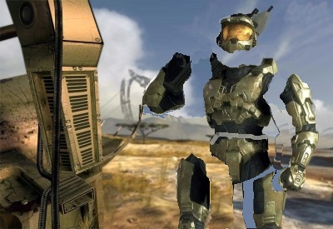
Client Application
(Halo 3)
BAM!!!
Player clicks mouse
cursor on target
OS: Recognizes interrupt
Sends it to client application
OS changes I/O devices to
show Master Chief blowing
up!!!
It's a mouse interrupt!
CLIENT
ut oh!
Client Application creates
message to send to server
application
ClientApplication generates
required images, etc.
Sends I/O requests to OS
SERVER
OS: Sends
Message to
server
OS: Receives
message and
sends it to
application
Application examines
message and state of
game and determines
Master Chief dies! Sends
message back to client.
Got a message!
OS: Receives
Message sends
to server application
OS: Sends
Message to client

Slide 41

What’s Inside the Box?

Slide 42


Slide 43


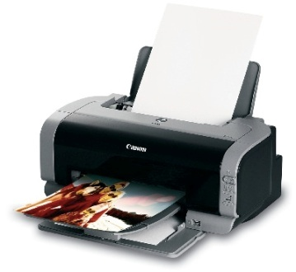
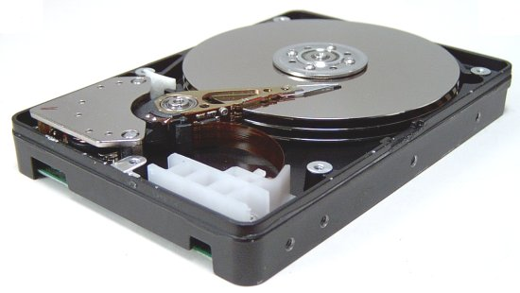
CPU
Graphics
controller
System bus
Bridge
I/O bus
Memory
Controller
Controller
Controller

Slide 44
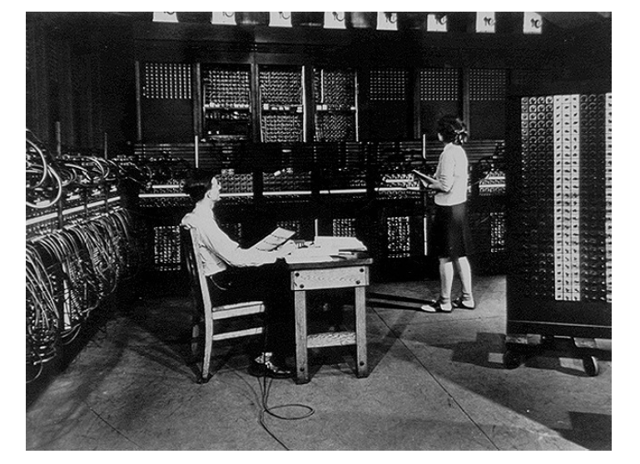
Architecture evolution

Slide 45
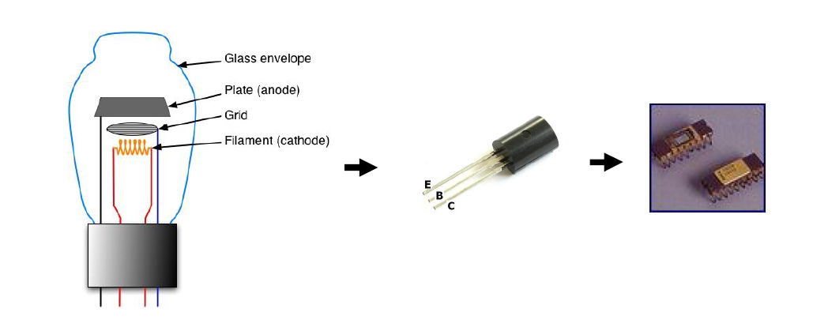
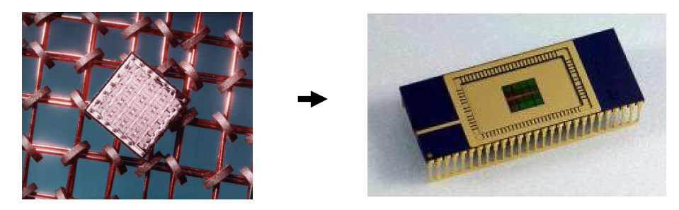

Slide 46
OS evolution
Mainframe, mini
FMS -> batch -> timesharing
PC/Desktops
GUI/Windows (Windows, MacOS)
Enterprise
Linux
Handhelds
Embedded OS (Symbian, Blackberry)
Derivatives (iOS, Android, Windows Mobile)
Grid/Cloud computing

Slide 47
This course?
Processor
Memory
I/O
Parallelism
Networking

Slide 48
Fundamentals of Programming
Fundamentals of Digital Electronic & Logic Design
Integrated Approach to Computer Architecture and Operating Systems
Advanced Topics in Operating Systems
Advanced Topics in Computer Architecture
Advanced Topics in Computer Networks

